Slide 1








Open-Source Scientific Computing for AgroGeospatial Big Data Analysis
Webinar about Phase 1 training
28th April, 2021
Part of a joint tailor-made course between Bangladesh Agricultural Research Institute (BARI), CIMMYT-Bangladesh, and ITC (Faculty of Geo-Information Science and Earth Observation , University of Twente).

Slide 2
This 90 minute webinar will cover
1 Introduction to the Phase 1 team
2 How the course “works”
3 How to use the platform
logging into the platform
changing your picture in the profile
changing your data in the profile
how to use the forum (post question, subscribe)
how to control your notifications
4 Introduction to the two courses, including information about exams
5 Questions

Slide 3

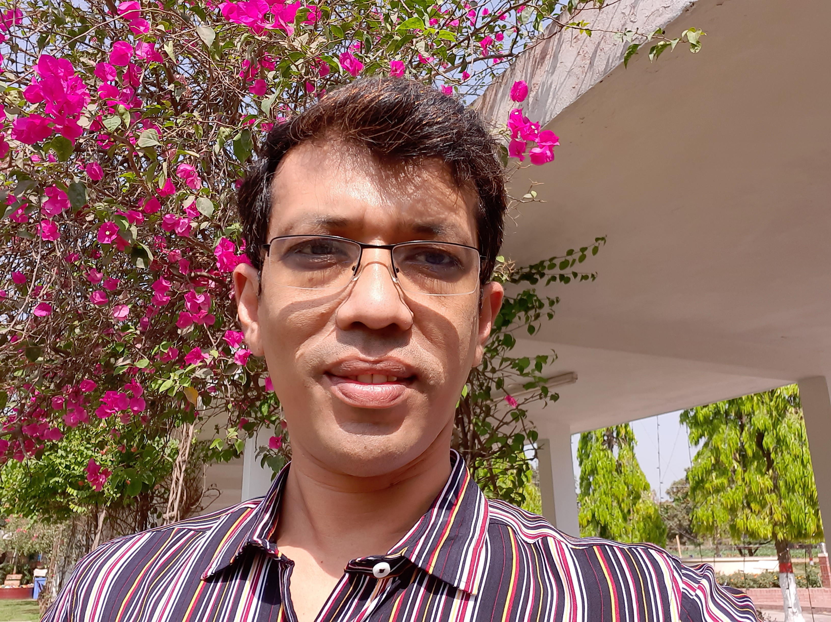

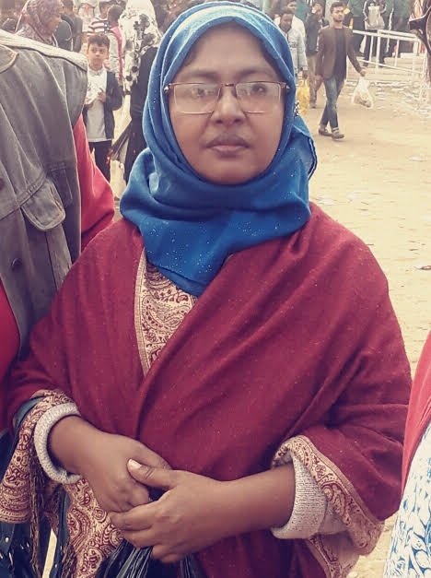
1 Who is who
Bangladesh Agricultural Research Institute Coordinating Team
Coordinator
Assistant coordinator
Gender advisor
Dr. Md. Golam Mahboob
Senior Scientific Officer
ASICT Division, BARI
Suman Biswas
Scientific Officer
ASICT Division, BARI
Dr. Reshma Sultana
Principal Scientific Officer
T&C Wing, BARI

Slide 4
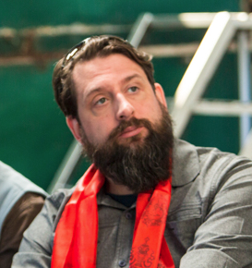
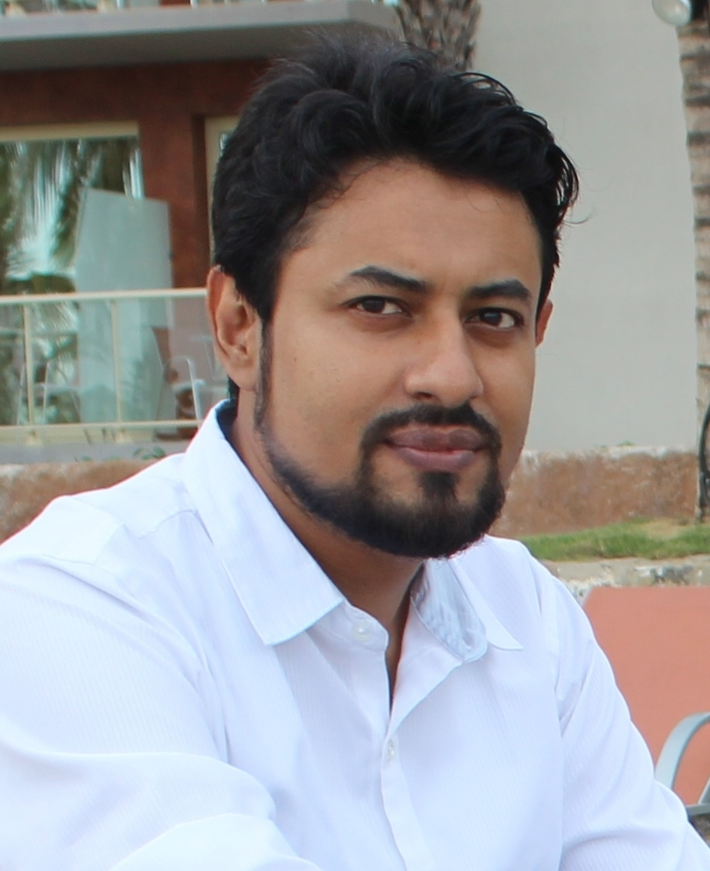
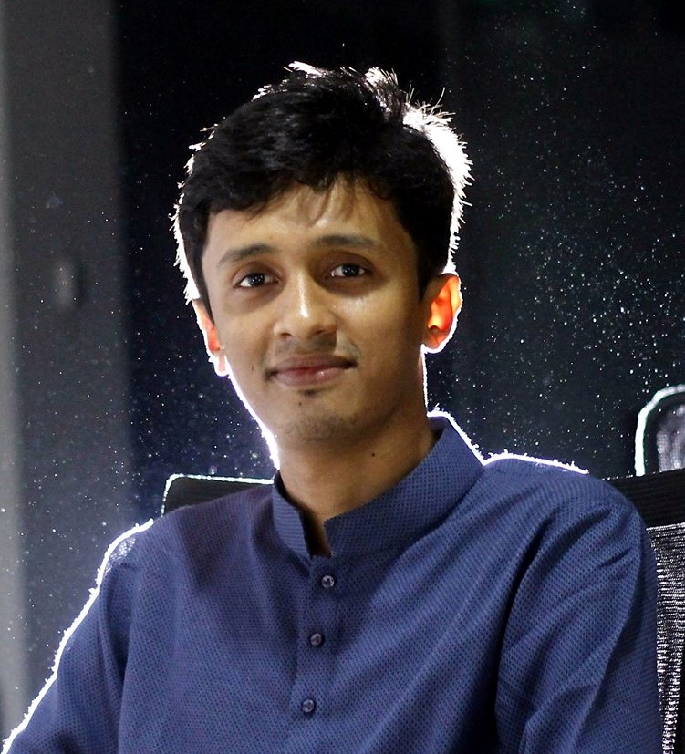
1 Who is who
International Maize and Wheat Improvement Center (CIMMYT) team
Training advisor & coordination
Training support
Training support
Dr Timothy J. Krupnik
Country Rep. - Bangladesh
Senior Scientist and Systems Agronomist
Mustafa Kamal
GIS and Remote Sensing Analyst
Asif Al Faisal
Data Analyst

Slide 5
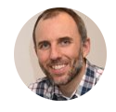









1 Who is who - phase 1
ITC (Faculty of Geo-Information Science and Earth Observation
Management team
Phase 1 lecturers
E-education specialists
Prof Andy Nelson - Spatial agriculture and food security
Lyande Elderink – project officer
Tia den Hartog – project officer
Dr Panagiotis Nyktas, Dr Margarita Huesca Martinez, Dr Mahdi Farnaghi, Dr Mahdi Kodadadzadeh, and Robert Ohuru
Ivan Oliveira & Laura Cray

Slide 6
2 How the phase 1 courses “work”
This is the first of four training phases in the training programme.
This phase runs from the 15th of March until the 15th of June.
This phase supports more than 100 trainees on “foundation” skills in Earth Observation and Scientific Programming.
All course material is made available through the MOODLE open-source learning platform moodle.org

Slide 7
2 How the phase 1 courses “work”
Phase 1 of the training programme contains two MOOC-style* courses which are followed entirely online.
  Introduction to Remote Sensing and Earth Observation
  Introduction to Scientific Programming
Each course requires around 80 hours of study to complete.
Each course concludes with an assessment (an exam) and we offer three exam dates for each course.
There will be one resit opportunity per course for a “failed” exam.
* “Massive Open Online Courses (MOOCs) are free online courses available for anyone to enrol.” Source: mooc.org

Slide 8
2 How the phase 1 courses “work”
The courses can be taken in parallel, or one after another, all at your own pace.
The material is designed for self-study.
Interaction with the lecturers takes place through the forums, where questions can be answered or group discussions can be moderated.
Mustafa and Asif (CIMMYT) have arranged weekly meet-ups on Zoom at 10am every Sunday to also address any questions from course participants.
“Massive Open Online Courses (MOOCs) are free online courses available for anyone to enroll” mooc.org

Slide 9
3 How to use the Moodle platform
How to use the platform and its functionality.
Show how to set up a profile.
How to use the forums for Q&A, troubleshooting, and discussion.

Slide 10
4 Introduction to the two courses
Short introduction to the two courses including exam dates, exam format, and example questions.

Slide 11
Introduction to Remote
Sensing and Earth Observation
Margarita Huesca Martinez
PANAGIOTIS NYKTAS

Slide 12
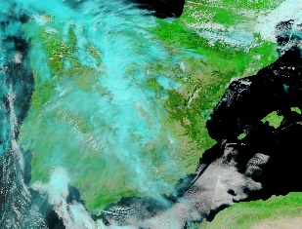
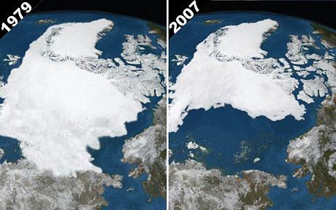
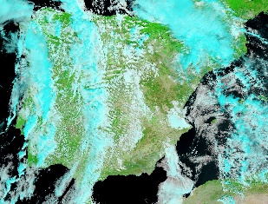
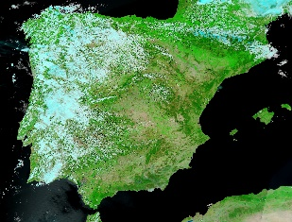
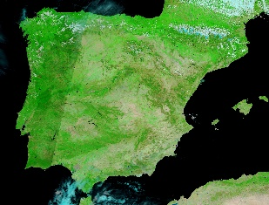
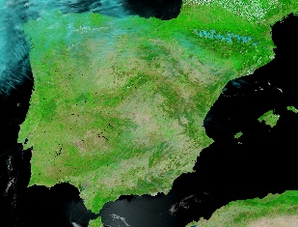
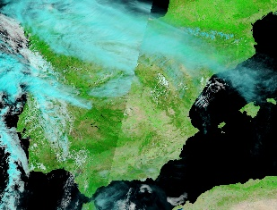
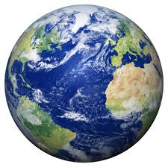
Why is Remote Sensing important?
Global temperate change
2000 → 2017
Remote sensing make it possible:
  To collect data of inaccessible areas
  To monitor environmental processes
  To collect information over large areas

Slide 13
Introduction to Remote Sensing and Earth Observation
This course will introduce you to some basic concepts and fundamental knowledge about Earth Observation through Remote Sensing as a technique for acquiring different types of geospatial information.

Slide 14
Learning objectives
Electromagnetic radiation processes to extract land cover information.
Image characteristics and select the most suitable sensor data to extract information.
Apply techniques for optimum visualisation of remotely sensed imagery.
Geometric transformations of Earth Observation images to address specific spatial questions.
Radiometric image correction and enhancement operations to improve image analysis.
Apply pixel-based digital image classification to extract information on the Earth's surface.
Work independently in solving a problem.
Notes:
Understand and apply knowledge about electromagnetic radiation processes in the atmosphere and Earth's surface to extract land cover information.
Translate geospatial questions into image characteristics and select the most suitable sensor data to extract information on the Earth's surface.
Apply techniques for optimum visualisation of remotely sensed imagery.
Choose and apply the appropriate geometric transformations of Earth Observation images to address specific spatial questions.
Apply appropriate radiometric image correction and enhancement operations to improve image analysis.
Apply pixel-based digital image classification to extract information on the Earth's surface.
Work independently in solving a problem, by integrating knowledge on the topics previously covered in the course.

Slide 15
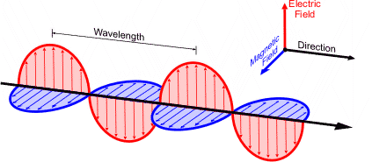
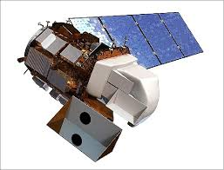

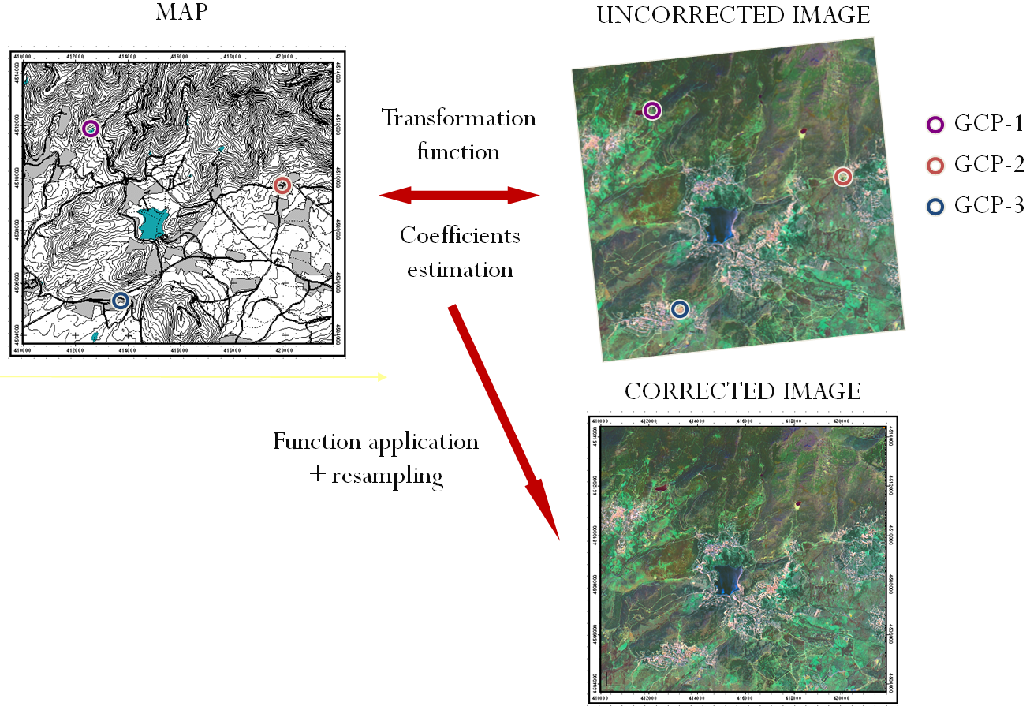
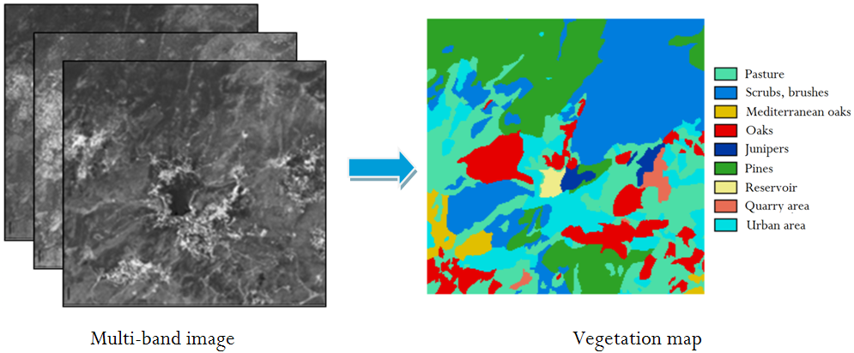
Course outline
1. Electromagnetic radiation
2. Sensors and image characteristics
3. Open-source software tutorial
4. Visualisation and radiometric operations
5. Geometric operations: Georeferencing and Geocoding
6. Digital image classification
Notes:
Each topic includes exercises for which we will provide model answers.
offered through reading material, recorded video lectures, discussions, tutorials and practical exercises

Slide 16
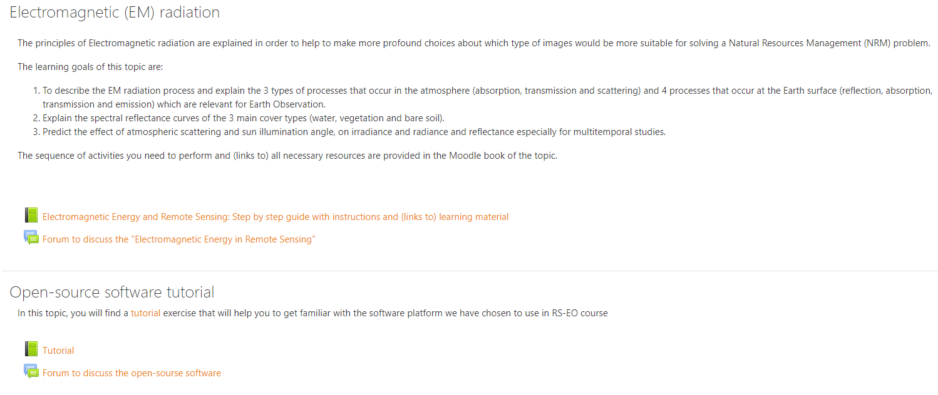
Communication & interaction in the course
Strongly recommended:
Post you questions and comments of Moodle fora!
Excellent way to interact asynchronously
You can find answers from fellow students post
Teachers will be also checking to answer questions.

Slide 17
Assessment
Final exam
Closed book - 90 minutes
Exam questions:
Multiple choice
Matching
True/false questions
Short numerical answers (no calculator needed)
Passing mark: 5.5/10

Slide 18
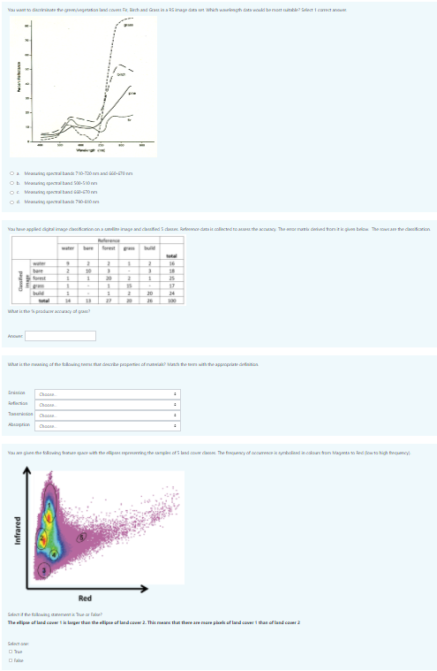
Assessment
Example exam questions are given in Moodle
Multiple choice (sensors topic)
Short numerical answers (DIC)
Calculator will not be needed
Matching (EM radiation)
True/false questions (DIC)

Slide 19
Assessment
Exam dates and (Dhaka) times:
Thursday 20th of May at 1pm
Friday 18th of June 8pm
Friday 9th of July at 8pm
Looking forward to interacting with you in Moodle fora
Good luck!

Slide 20
Introduction to Scientific Programming

Slide 21
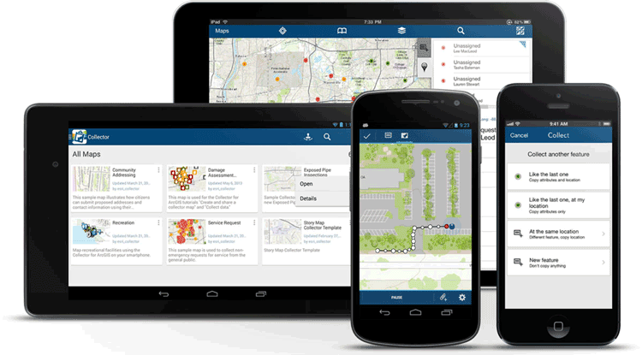

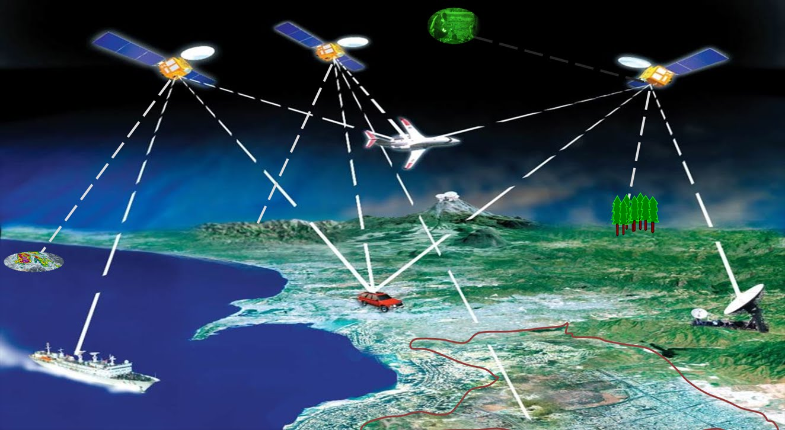
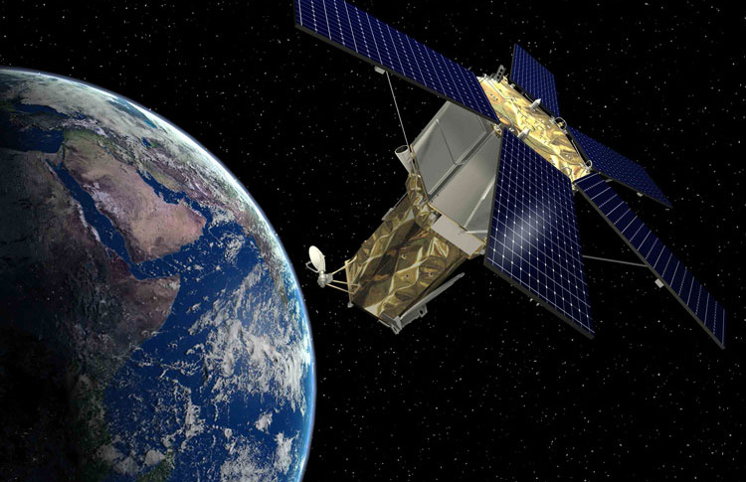

Huge amount of spatial data
  Satellite imagery
  GPS sensors
  Mobile devices
  Internet of Things
  Social networks
Petabytes of geodata is collected everyday
https://www.gislounge.com/evolution-mobile-mapping/
https://www.networkworld.com/article/3270961/internet-of-things/10-hot-iot-startups-to-watch.html
https://spacenews.com/nga-boeing-tap-geoeye-satellite-imagery-products/
https://meco6936.wordpress.com/2017/04/28/location-based-social-networking-is-leading-a-new-era-to-explore-life/

Slide 22
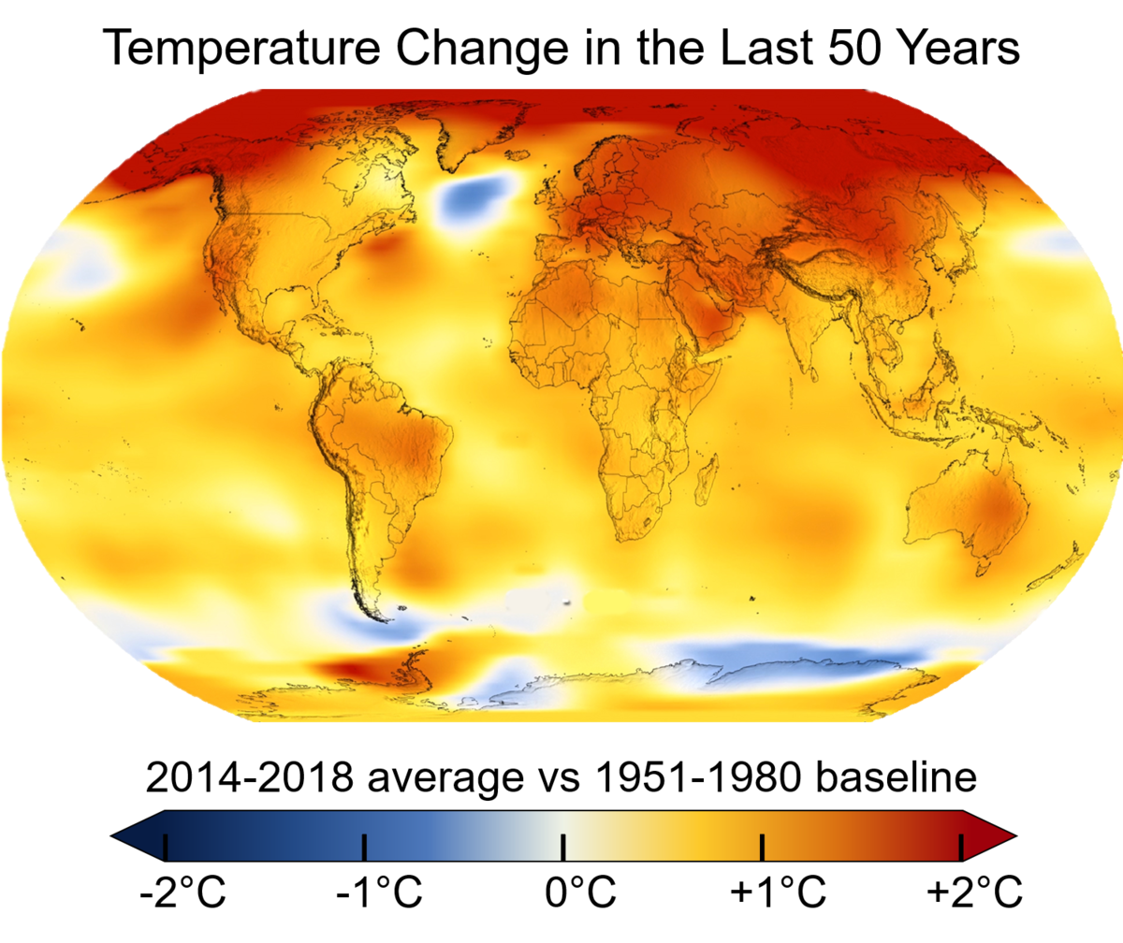
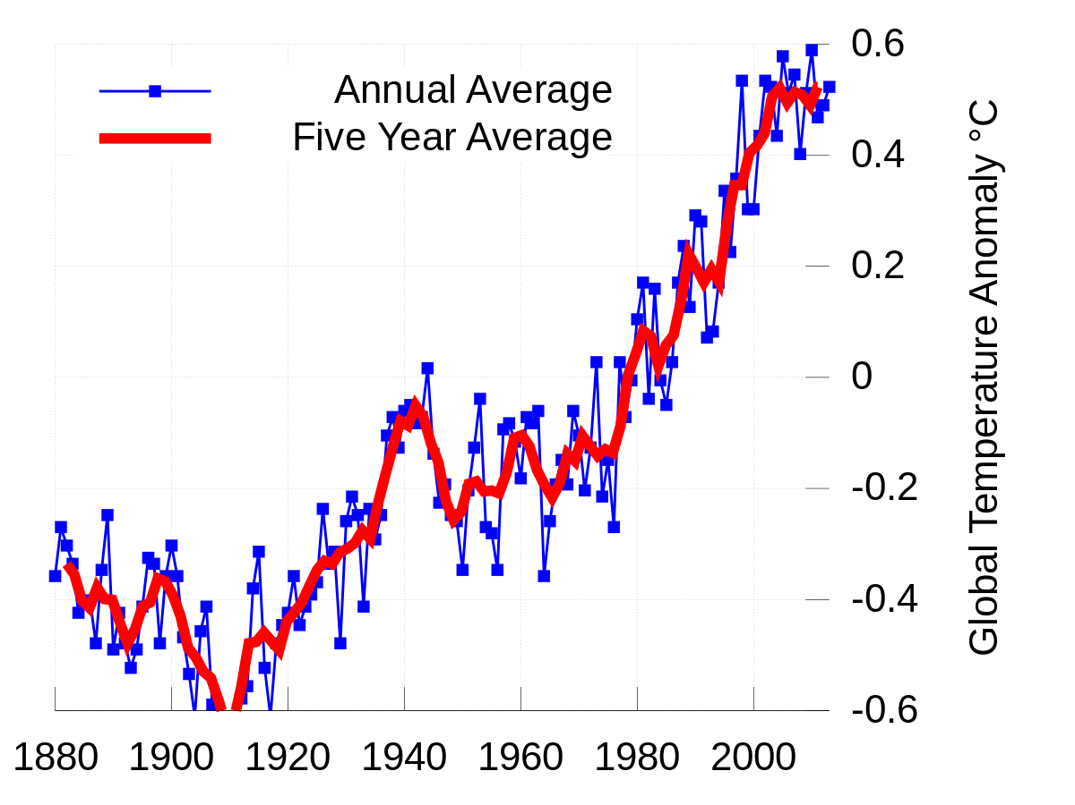
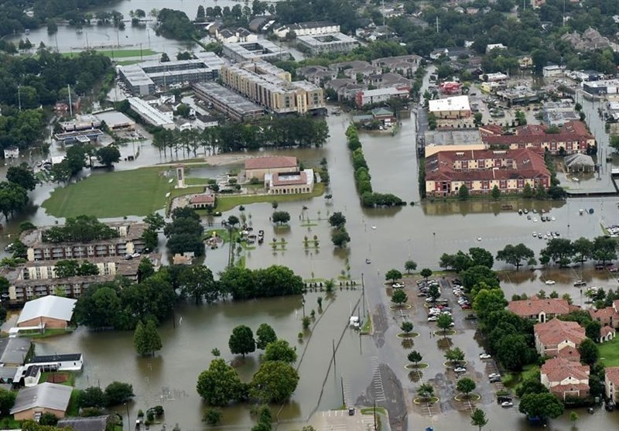
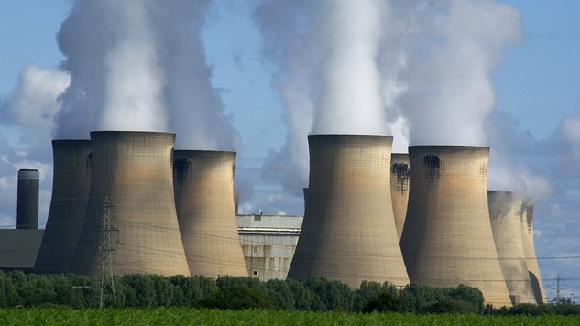
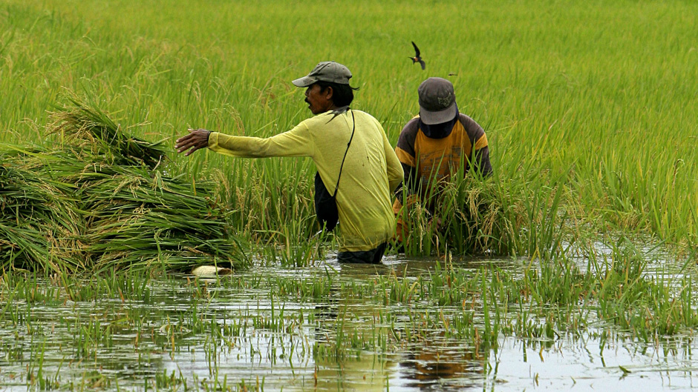
Opportunity
Tackle a wide range of problems that had been out of reach before
  Climate change
  Deforestation
  Food security and sustainability
  Air pollution
  Natural Disasters
  …
This Photo licensed under CC BY-SA-NC
This Photo is licensed under CC BY-SA
This Photo is licensed under CC BY
This Photo is licensed under CC BY
This Photo is licensed under CC BY-SA-NC

Slide 23
Motivation for this course
Working with complex data sources
New skills and dexterities
Scientific Programming
Access different data sources
Manipulate the data
Explore the data
Analyze the data
Present the output
Introduction to Scientific Programming
An introductory course
Basic scientific programming concepts
Python
Spatial data analytics.

Slide 24
Learning objectives
Understand the syntax of Python programming language and data structures.
Learn how to better design, develop and implement solutions with Python programming.
Equip you with knowledge required to write programs that perform automated task.
Equip to the background knowledge about theory of computer programming, pragmatics, and literate programming.
Be able to work with scientific libraries for mathematical analysis and generating charts.
Be able to manipulate vector and raster data in Python and develop simple processing procedures.
Be able to choose and apply a proper approach to integrate raster and vector data.
Work independently in developing python script to solve scientific problems by integrating knowledge on the topics covered in the course

Slide 25
What we have in store for you
Python basics
Scientific Libraries
Modules
Algorithmics
Geoprocessing

Slide 26
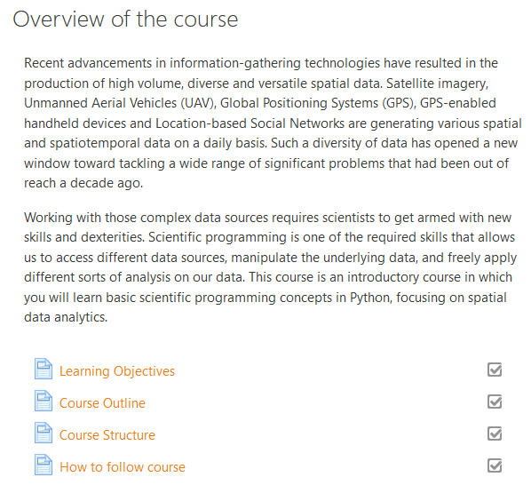
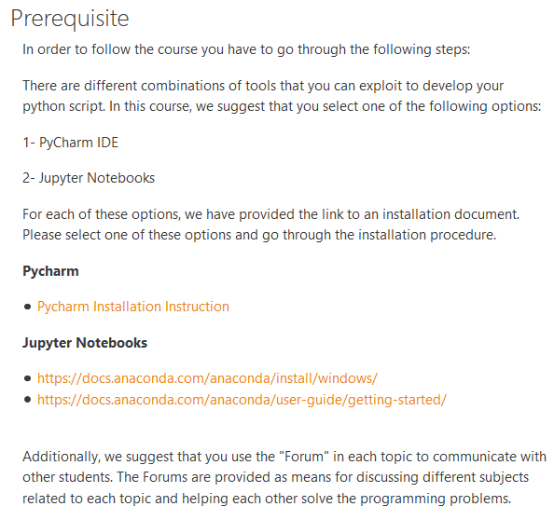
How to follow the course

Slide 27

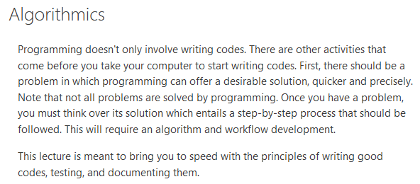



4 Course Modules

Slide 28
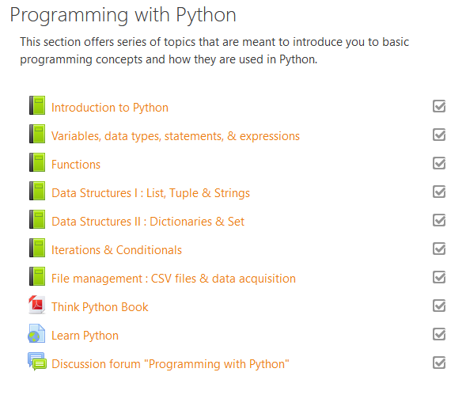
Modules
Several topics (composed of several pages)
Topics
  Reading material
  Recorded video lectures
  Presentation files
  Tutorials
  Practical exercises
Implement everything on your machine
Use the forums to get help from other students and share what you learn with them. Peer-to-peer discussion is highly encouraged.
Answers to each exercise will be published
Check your outputs with the answers

Slide 29
How much time?
Topic | Content | Approximate time (hours) for full-time students
1 | Python basics | 38
2 | Algorithmics | 2
3 | Scientific Libraries | 17
4 | Geoprocessing | 23
 | Total | 80

Slide 30
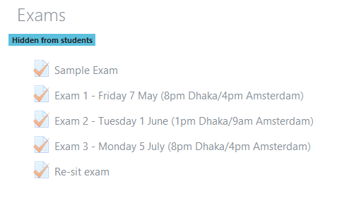
Exam
3 rounds of exams
1 resit exam – the date will be announced
Multiple choice
90 minutes
Two categories of questions
  Programming knowledge (concepts or syntax)
  Programming dexterities

Slide 31
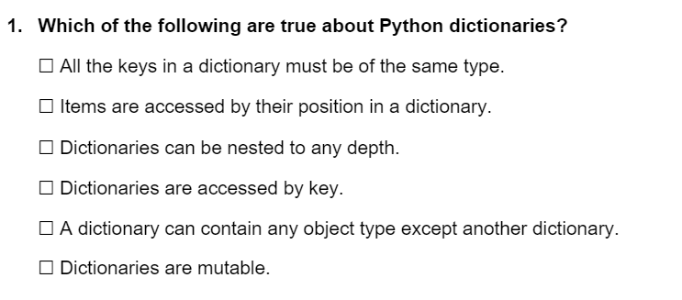
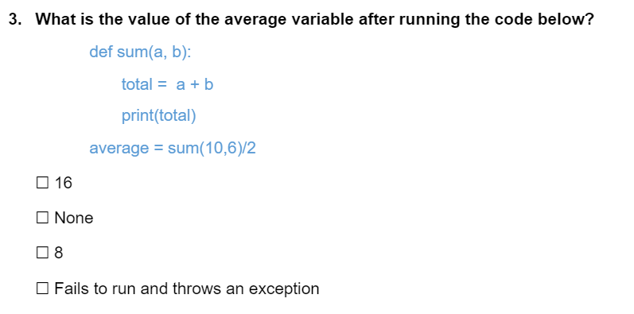
Sample questions

Slide 32
Finally …
This course prepares for other courses in the project
This course offers learning generic tools that last a lifetime … thus are worth investing in
These tools are central skills to the scientific profession

Slide 33
5 Questions?
Can instructions of coding be presented in a video with the pycharm window?
QGIS has been updated, but the modules are based on older versions of QGIS – is there any chance to update the lecture based on updated QGIS software
Practice oriented video tutorials would be more effective to follow the lecture

Slide 34
About the training programme
Phase I
Phase II
Phase III
Phase IV
Medium: Online (MOOC)
Duration: Mar 15 - Jun 15
Participants: 100-150 from BARI & Sister Organizations
Courses:
Introduction to Remote Sensing and Earth Observation
Introduction to Scientific Programming
Medium: Online courses
Duration: Jun 15 - Sep 30
Participants: 20-25 Participants / course from BARI & Sister Organizations
Courses:
Geospatial Data Analysis with Python
Spatiotemporal Machine Learning with Python
Crop growth modelling
Agricultural Monitoring with Remote Sensing
Medium: Training at ITC, Netherlands
Duration: 2 weeks, Oct
Participants: 6-8 Participants/course from BARI only
Courses:
Quantitative Remote Sensing of Vegetation
Big Geodata Analytical Methods and Distributed Computing
Big Data Analytics in Agriculture
Medium: Mentored training in the workplace
Duration: Nov 1 – Feb 28
Participants: 5 Participants / group project
Activities:
Group projects on the usage of Agro-Geospatial Big Data will be conducted relevant to the work of institutional mandate guided by the assigned supervisors from ITC/CIMMYT.
Phase V (Mar 22)
A stakeholders’ workshop will be held at Dhaka to disseminate the outcome at the end of project.
In all phases, we aim at a 50/50 balance between female and male participants.

